Slide 1


Games on graphs
Innovative ideas to tackle reachability and safety games

Slide 2

LINE OF CONTENTS
PERSONAL OPTIMIZATIONS
EXPERIMENTAL PHASE
FUNDAMENTALS
MULTIPLE PERSPECTIVE ALGORITHM
CONCLUSIONS

Slide 3

Fundamentals

Slide 4
PROJECT’S SCOPE
Number of players:
2 players
Interaction:
Turn-based
Information:
Perfect
Nature:
Deterministic
Objective:
Reachability/Safety

Slide 5
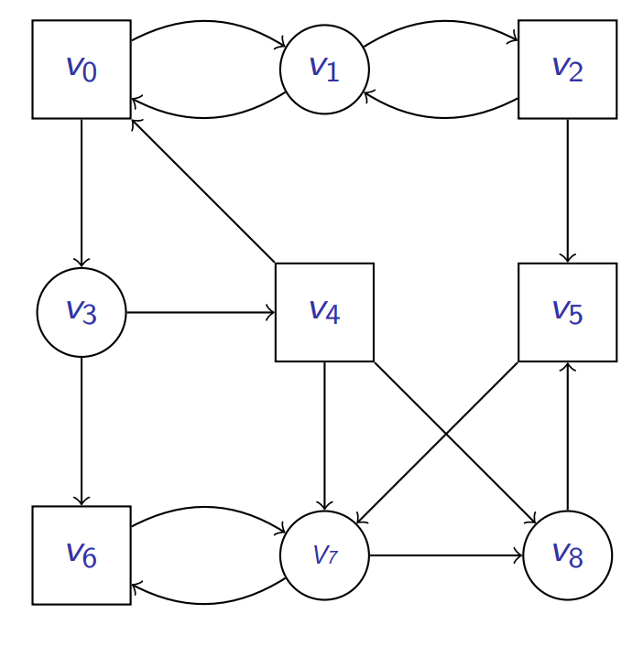
GAMES ON GRAPHS: FUNDAMENTALS
A game is played over a (finite) graph G = (V, E), whose vertices are under the control of the two players, i.e., V = V₀ ⋃ V₁
A token moves along the vertices and sent to a successor by the controlling player.

Slide 6
GAMES ON GRAPHS: FUNDAMENTALS
The play is an infinite sequence of vertices in the graph.
A winning objective is a subset Obj ⊆ V_{ω} of plays that Player₀ wants to occur.
A sample of an (infinite) play is:
𝛱 = v₀ ᐧ v₁ ᐧ v₂ ᐧ v₁ ᐧ v₂ ᐧ v₁ ᐧ v₀ ᐧ … ∈ V_{ω}

Slide 7
GAMES ON GRAPHS: FUNDAMENTALS
For a subset of vertices T ⊆ V:
Reachability: visit the target set T at least once.
Reach(T) = {π ∈ V^{ω} | ∃ i ∈ N, π_{i} ∈ T}
Safety: stay in T forever.
Safe(T) = {π ∈ V^{ω} : ∀ i ∈ N, π_{i} ∈ T}

Slide 8
GAMES ON GRAPHS: FUNDAMENTALS
A strategy maps finite sequences of vertices into successors and it is of the following form:
Player₀ strategy σ₀ : V∗ · V₀ → V
Player₁ strategy σ₁ : V∗ · V₁ → V
Strategies “restricts” the game only to those play π that are consistent with σ0, that is such that π_{i+1} = σ₀ (π₀ · π₁ · . . . · π_{i}), if π_{i} ∈ V₀.
For given strategies σ0, σ1, there is only one consistent play starting from v.

Slide 9
GAMES ON GRAPHS: FUNDAMENTALS
A strategy σ₀ is memoryless if it is of the form
σ₀ : V* · V → V that is, at every vertex v, the next move does not depend on the past history.
Theorem:
If v ∈ Win₀, then there exists a memoryless strategy σ₀ that is winning from v.

Slide 10
GAMES ON GRAPHS: FUNDAMENTALS
Formulation of the force function for reachability games:
Reach_comp(X) = {v ∈ V_{R}: E(v) ⋂ X ≠ ∅ }
Safety_comp(X) = {v ∈ V_{S}: E(v) ⊆ X }
Force_{Reach}(X) = Reach_comp(X) ⋃ Safety_comp(X)
Formulation of the force function for safety games:
Reach_comp(X) = {v ∈ V_{R}: E(v) ⊆ X }
Safety_comp(X) = {v ∈ V_{S}: E(v) ⋂ X ≠ ∅ }
Force_{Safety}(X) = Reach_comp(X) ⋃ Safety_comp(X)

Slide 11
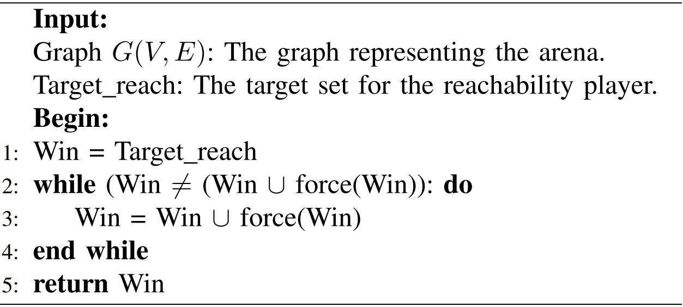
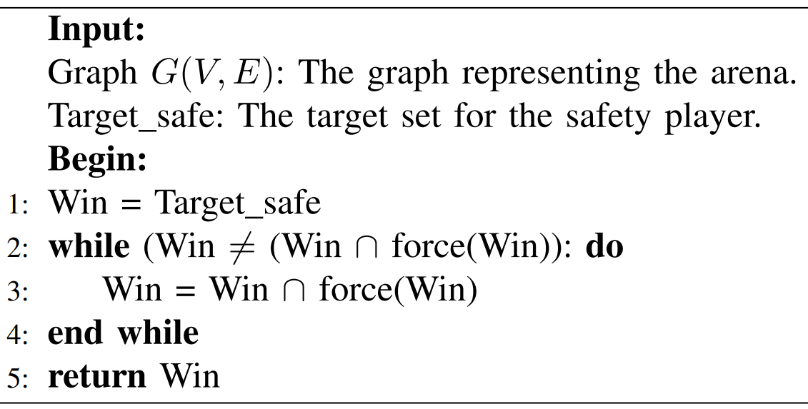
GAMES ON GRAPHS: FUNDAMENTALS
Corresponds to compute the approximate least fixpoint.
Corresponds to compute the approximate greatest fixpoint.

Slide 12
Personal Optimizations

Slide 13
Transpose graph optimization

Slide 14
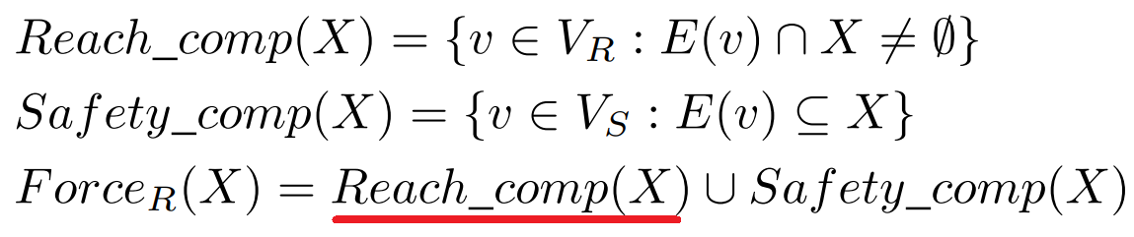
ON WHICH COMPUTATION ARE WE IMPACTING WITH THIS OPTIMIZATION?

Slide 15
TRANSPOSE GRAPH OPTIMIZATION: COMPUTING REACH_COMP(X)
Given a graph G and an input target set X, we define the neighborhood of the target set in the transpose graph GT as follows:
N_{GT} := { x ∈ X | ( x ⊆ Neighbors (GT, x ) ) }
With reference to formulation of reachability games, Reach_comp(X) will include all the node v ⊆ V that satisfy the following conditions:
a) The node v is controlled by the reachability player (i.e., v ∩ R).
b) The node v belongs to the set N_{GT} (i.e., v ∈ N_{GT}).
It is convenient to employ the transpose graph instead of the straight graph to verify whether condition b) is fulfilled.

Slide 16
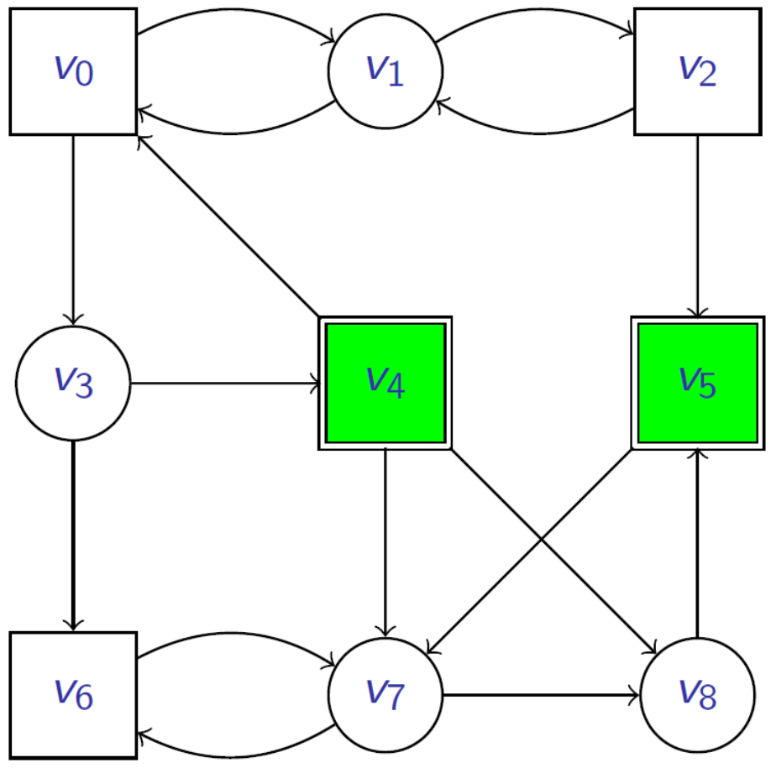
TRANSPOSE GRAPH OPTIMIZATION: GRAPHICAL INTUITION
Processed nodes using the “straight” graph:
V_{P} = {v₁, v₃, v₇, v₈}.
Processed nodes using the transpose graph:
V_{P’} = {v₃ , v₈}.
Regardless of the data structure employed:
Reach_Comp(X) = {v₃, v₈}.

Slide 17
TRANSPOSE GRAPH OPTIMIZATION: COMPUTING SAFETY_COMP(X)
With reference to formulation of reachability games, Safety_comp(X) will include all the nodes v ⊆ V that satisfy the following conditions:
a) The node v is controlled by the safety player ( i.e., v ∩ S).
b) The node v belongs to the set N_{GT} ( i.e., v ∈ N_{GT} ).
c) All the outgoing edges of the node v ⊆ V lead to nodes contained in the target set X (i.e., v ∈ V | E(v) ⊆ X).
Hybrid approach: we employ the transpose graph to check the fulfillment of condition b), while we use the straight graph to check if condition c) is verified.

Slide 18
Current set optimization

Slide 19
ON WHICH COMPUTATION ARE WE IMPACTING WITH THIS OPTIMIZATION?

Slide 20
CURRENT SET OPTIMIZATION
With reference to the formulation of reachability games:
Current set := set of nodes added in the last iteration to the reachability player’s winning set.
It corresponds to the Force_{Reach}(X) computed in the algorithm’s previous iteration.
The Current set is generally a subset of the winning set W.
We combine this optimization with the transpose graph optimization:
We verify the fulfillment of the conditions a) and b) exclusively for the nodes reachable from the Current set, instead of verifying whether these conditions hold for the set of nodes reachable from the entire winning set.

Slide 21
CURRENT SET OPTIMIZATION:
PROOF OF CORRECTNESS
Using this optimization, the nodes candidate to enter the target set T are only the nodes that have not been considered yet.
The nodes added in the previous iteration fall within the following cases:
The node is not reachable from the target set with a single edge
→ The node has not been added to the target set in the previous iteration
The node is not reachable from the target set through two edges
→ The node must be necessarily added to the force set (and thus to the target set T) in the previous iteration.

Slide 22
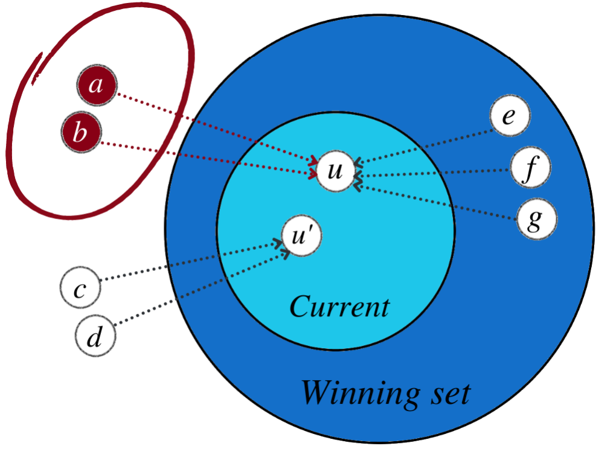
CURRENT SET OPTIMIZATION: GRAPHICAL INTUITION
Suppose the node considered in the current iteration is node “u”:
The only nodes we desire to process are nodes “a” and “b”.
Considering nodes “e”, “f,” “g” is detrimental!
Nodes “c” and “d” will be processed when node “ u’ ” is considered.

Slide 23
“Processed” list optimization

Slide 24
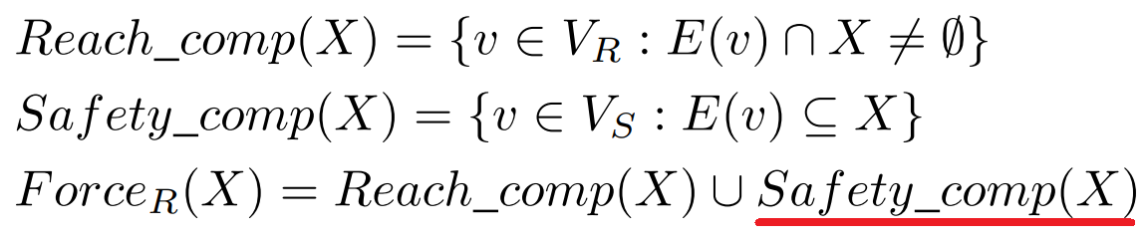
ON WHICH COMPUTATION ARE WE IMPACTING WITH THIS OPTIMIZATION?

Slide 25
PROCESSED LIST OPTIMIZATION: COMPUTING SAFETY_COMP(X)
As before, we refer to formulation of reachability games.
Thus, we define:
L := The losing set for the reachability player
(i.e., the current set of safety nodes)
V_{S} := The set nodes controlled by the safety player
SCL := The set of nodes controlled by the safety player that are solely connected with nodes belonging to L.
The goal is to compute SCL, which coincides with Safety_comp(X) in the previous formulation.

Slide 26
PROCESSED LIST OPTIMIZATION: THE PROBLEM
To verify the condition c):
We iterate through the set V_{S} and for each node u ∈ L
We examine all the nodes controlled by the safety player solely connected with “u” ∈ L or with another node “ u’ ” ∈ L.
Possible scenario → A node v is encountered, firstly, as a neighbor of the node “u” and, secondly, of the node “ u’ ”.
Problem: some nodes may be processed multiple times!

Slide 27
PROCESSED LIST OPTIMIZATION:
THE SOLUTION
The result of the operations carried out is independent of the fact that the node “v” is a neighbor either of the node “u” or the node “ u’ ”!
Hence:
We insert each considered node into Processed, a list that contains the processed nodes.
In doing so, once a node has been already examined as the neighbor of a node “u”, it will not be considered again, if it is encountered as the neighbor of another node “ u’ ”.
In doing so, the computation of SCL (i.e., Safety_comp(X)) has been optimized!

Slide 28
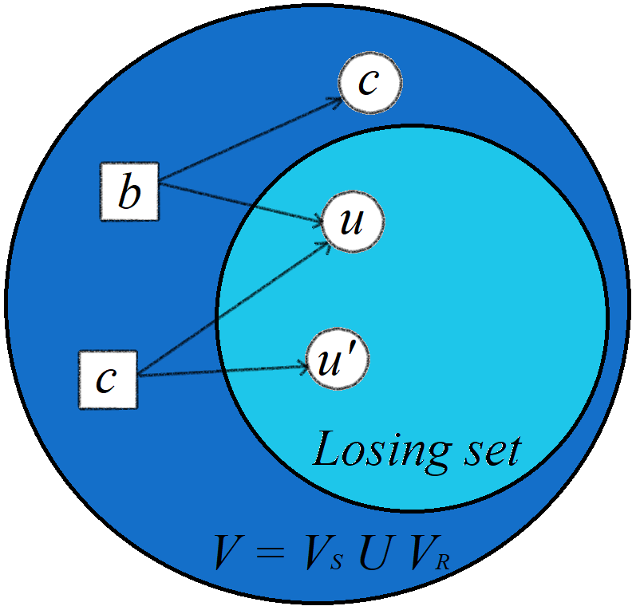
“PROCESSED” LIST OPTIMIZATION: GRAPHICAL INTUITION
Suppose the node considered in the current iteration is node “u”:
The node “b” is processed. It is not safe since it is not solely connected to nodes in the losing set. We add “b” to the “processed” list.
The node “c” is processed. This node is safe, hence it is added to the set SCL. Then we add this node to the “processed” list.
Then we consider the node “ u’ ”:
The node “c” has already been processed as a neighbor of “u”, hence it is not processed again as a neighbor of “ u’ ”.

Slide 29
Multiple-perspective algorithm

Slide 30
MULTIPLE PERSPECTIVE ALGORITHM:
INTUITION
The multiple perspective algorithm combines the two logic underpinning:
The pure forward
The pure backward
At each iteration, the algorithm determines whether it is convenient to tackle the problem from either the reachability or safety player’s point of view.

Slide 31
MULTIPLE PERSPECTIVE ALGORITHM:
INNER FUNCTIONING
Start → The algorithm starts to solve the game as a safety game
Execution →
If the winning set’s size is less than or equal than a threshold t = floor(|V|/2)
It is convenient to perform the forward step
Otherwise:
it is convenient to execute the backward step.
End →The algorithm returns the winning set for the safety player.

Slide 32
THE EMPLOYED HEURISTIC AT A GLANCE
It proceeds “backward”.
The algorithm solve the game as a reachability game
Threshold = floor(|V|/2)
The algorithm solve the game as a safety game
It proceeds “forward”.

Slide 33
MULTIPLE PERSPECTIVE ALGORITHM:
CAVEAT
The actual complexity of each step depends on the degree of the nodes involved in the computation!
Hence, the criterion employed to determine whether it is convenient to switch point of view is not an accurate indicator, but it is just used as a heuristic!

Slide 34
MULTIPLE PERSPECTIVE ALGORITHM:
PROOF OF CORRECTNESS
Note that taking a step instead of another does not undermine the correctness of the algorithm!
To provide an immediate intuition:
Changing the point of view at each iteration can be viewed as generating at each iteration a new game, in which the target set given in input is the winning set returned by the step executed at the previous iteration.
In this respect, each iteration is independent of the previous one.
Hence switching between the two points of view as the game progresses does not affect the algorithm’s correctness.

Slide 35
Experimental phase:
Results and discussion

Slide 36

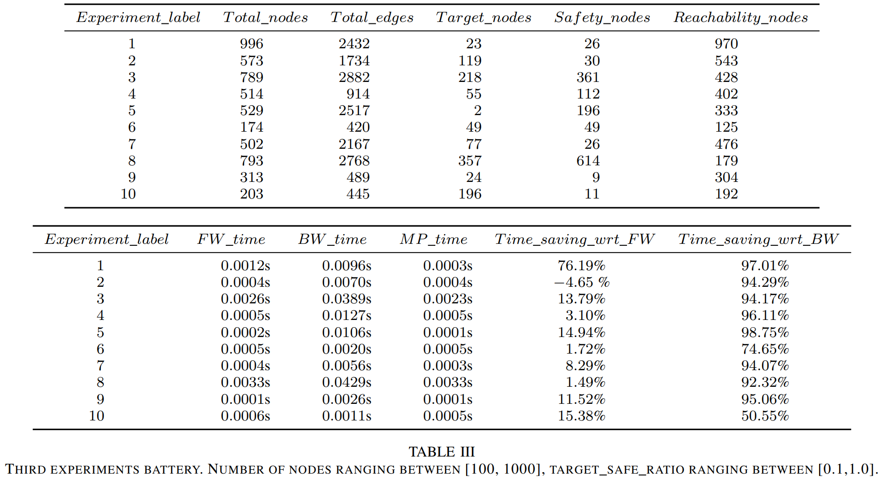

Slide 37
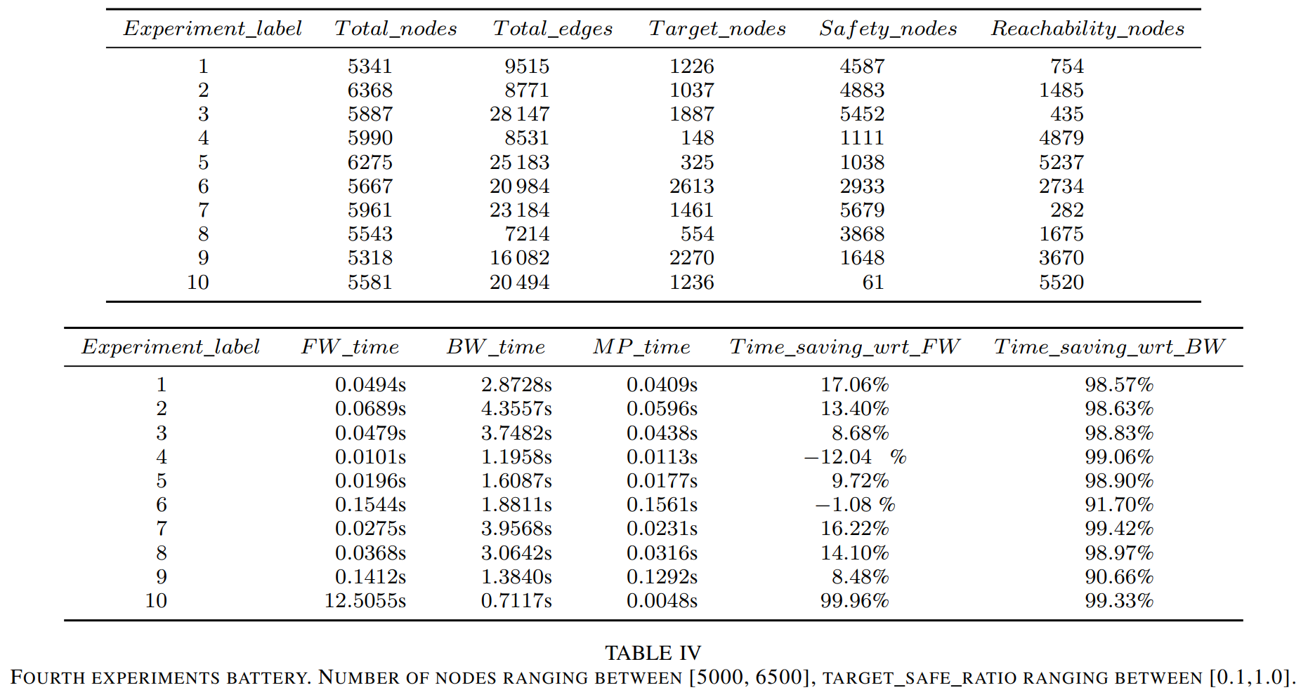

Slide 38
DISCUSSION OF THE RESULTS
The multiple-perspective algorithm performs better than its naive counterparts on the average case!
The cases in which the multiple-perspective algorithm is slower than the naive ones show that the difference in terms of the required time is not particularly relevant.
There are some cases in which the algorithm profoundly outperforms both the naive counterparts (e.g., first table experiment 1, second table experiment 10).

Slide 39
DISCUSSION OF THE RESULTS
From all the experiments conducted, we can state that the multiple-perspective algorithm profoundly outperforms the backward algorithm in every conducted experiment.
This is because most of the optimizations proper of the multiple-perspective algorithm have been designed to improve the algorithm’s capabilities to solve reachability games.

Slide 40
DISCUSSION OF THE RESULTS
When the pure forward algorithm performs better than the multiple-perspective algorithm?
The multiple-perspective algorithm has two additional costs when solving games:
The cost related to the the generation of the transpose graph
The cost of switching point of view (i.e., computing the complement of the winning set).
The multiple-perspective algorithm is slower when the time required to compute the additional data structures exceeds the time saved through the carried-out optimizations!

Slide 41
DISCUSSION OF THE RESULTS
However, we remark another crucial factor:
The game starts as a safety game, hence it is given as input the target set for the safety player.
The backward algorithm is disadvantaged because it has to compute the complement of the target set and then solve the game as a reachability game.
If the starting size of the winning set is greater than half of the total number of nodes, the multiple perspective algorithm experiences the same disadvantage!
(It performs better than the backward algorithm thanks to the optimizations)

Slide 42
CONCLUSIONS - THE PROJECT’S STEPS
Objective 1 ✔
Objective 2 ✔
Objective 3 ✔
Objective 4 ✔
Implementation of the canonical versions of the algorithms to solve reachability and safety games
Design and development of a novel algorithm that combines the logic underpinning safety and reachability games
Design and implementation of several algorithmic optimizations
Testing of the proposed algorithm through randomized experiments

Slide 43

Questions?

Slide 44

Thank you

